Slide 1
ERP SYSTEM FOR COLLEGE MANAGEMENT
Group-3

Slide 2
Team Members
Employee Id | Names
2496232 | Devashish Sinha(Team Lead)
2495296 | V Narayanan(Back-End Lead)
2495772 | N Smruti Ranjan Reddy (Front-End Lead)
2495545 | Pooja Wamanrao Pawar
2496045 | J.Haritha
2496213 | Kedam Rajesh
2496220 | Mohammad Abed Ali
2496226 | Vaibav Satish Atkare
2496060 | Bussareddy Anil
2495922 | Dudekula Kalam Basha

Slide 3
Project Objective
To create a dynamic and responsive java full stack web application for
ERP System for College Management.
With Modules like:-
Student
Faculty
Admin

Slide 4
Problem statement
In Existing System for managing various modules such as Student module, Administrative module and Exam cell etc. takes lot of paper work as well as time.
In Administrative module Timetable, and updation details, Profile views, Fees details, Results ,Events etc. all are very difficult to manage using manual processes and it takes lot of time and paper work.

Slide 5
Solution
ERP stands for Enterprise Resource Planning.
Enterprise resource planning (ERP) is business management software or a system which is typically used to manage core departmental data of respective business.

Slide 6
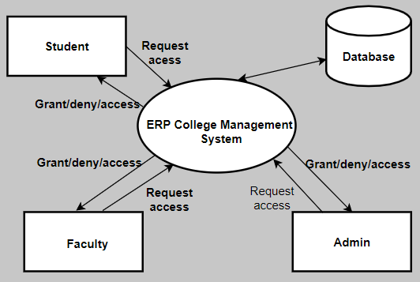
INTRODUCTION
ERP for College Management System:
ERP is tool used to collect college operations data and analyse.
Management uses this data to make informed decisions

Slide 7
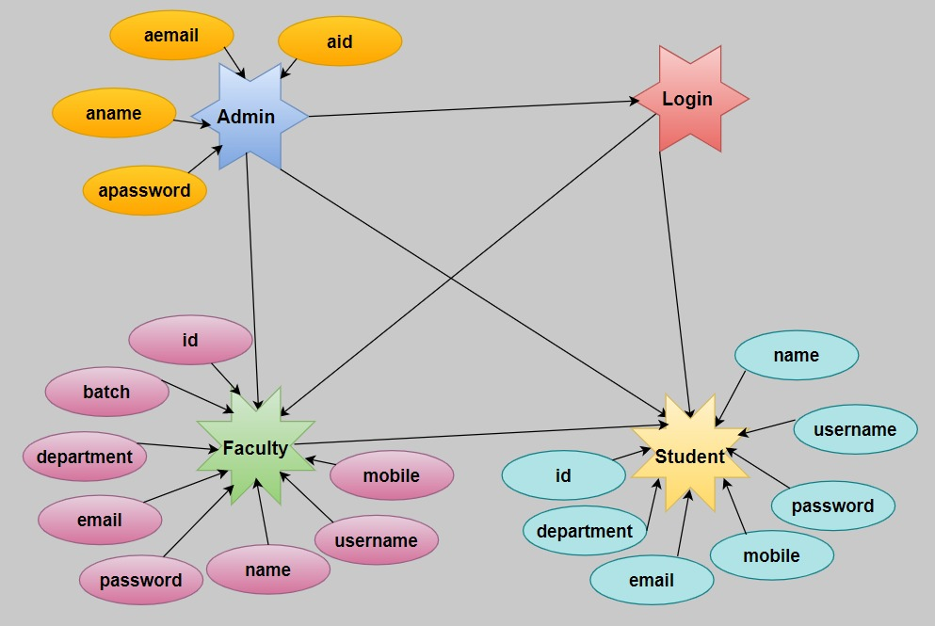
E-R Diagram

Slide 8
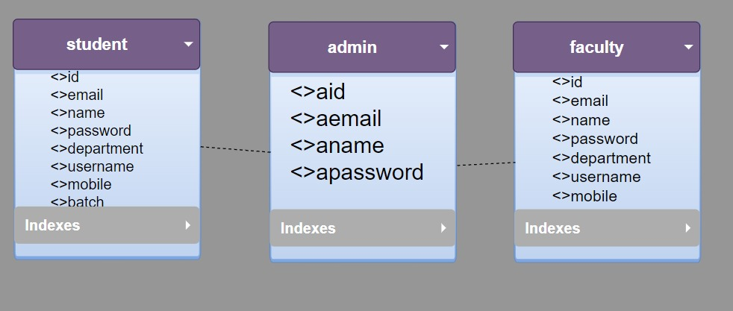
schema

Slide 9
Modules
Home Page
About Us
Contact
Student
Student Login
View Result
View Time-Table
Faculty
Faculty Login
Add Result
Add Time-Table
Admin
Add Student
Add Faculty
View Faculty
View Student

Slide 10









Tools and Technologies
Front end: Angular
Server Side: Spring Boot
Back-end: Hibernate, MY SQL
Server: Tomcat 8.0
API platform : Postman
Programming language
Code Editor & IDE User
VisualStudio Code
Eclipse IDE

Slide 11
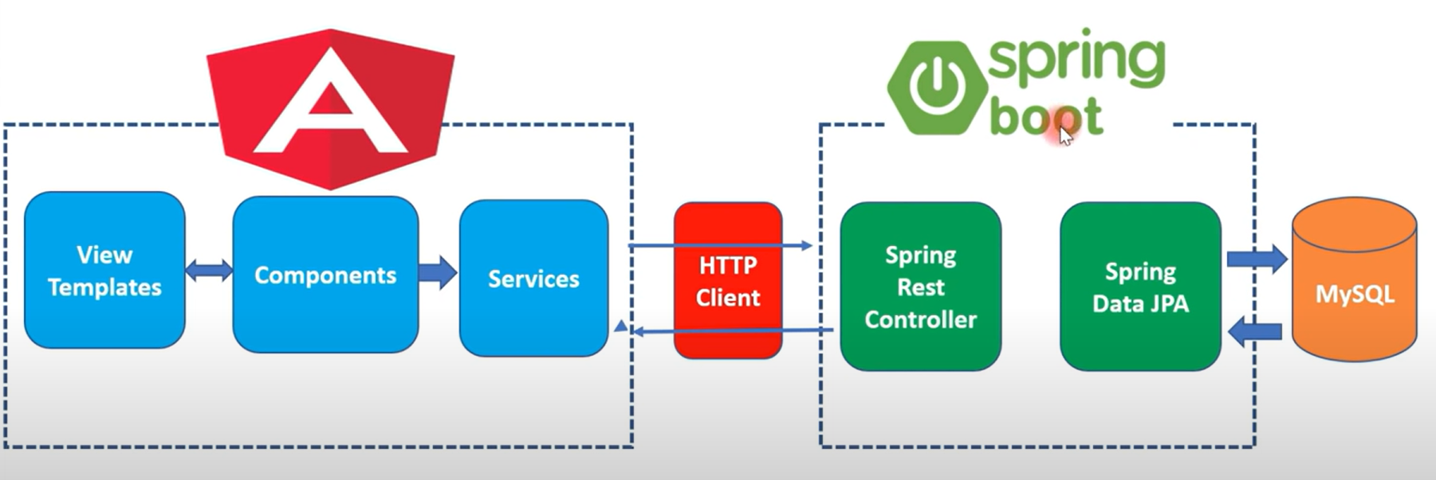
Angular + Spring boot Crud Full stack

Slide 12

Home-PAGE

Slide 13
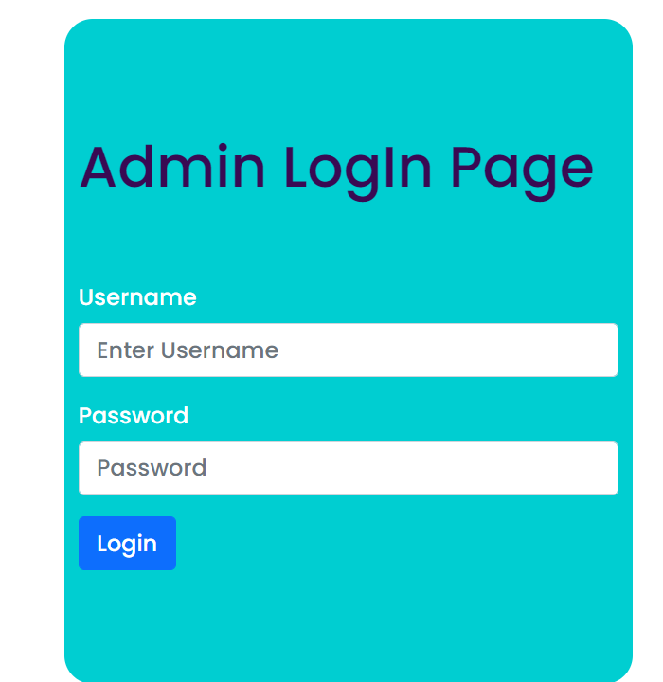
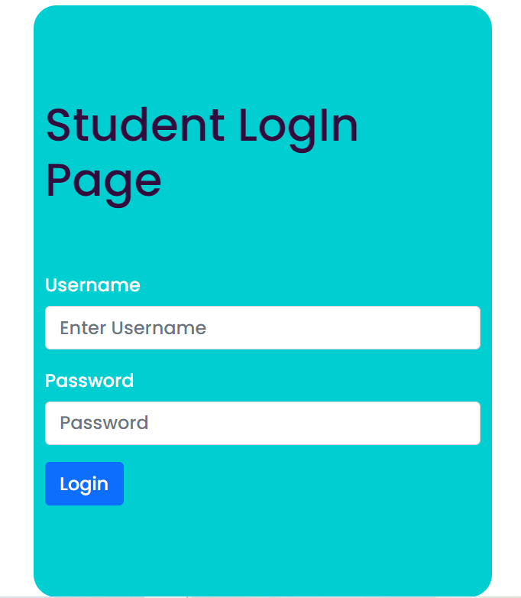
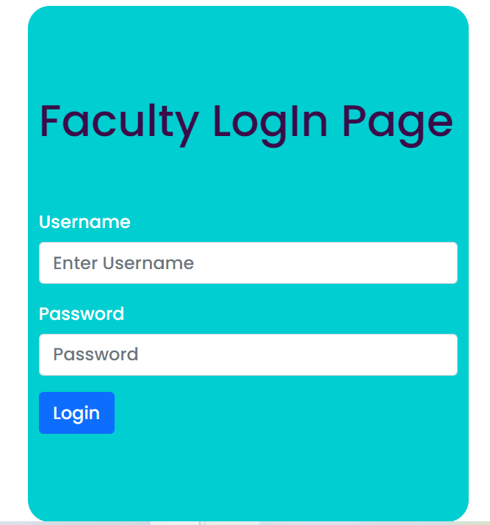
LoGin Pages

Slide 14

Admin Home PAge

Slide 15
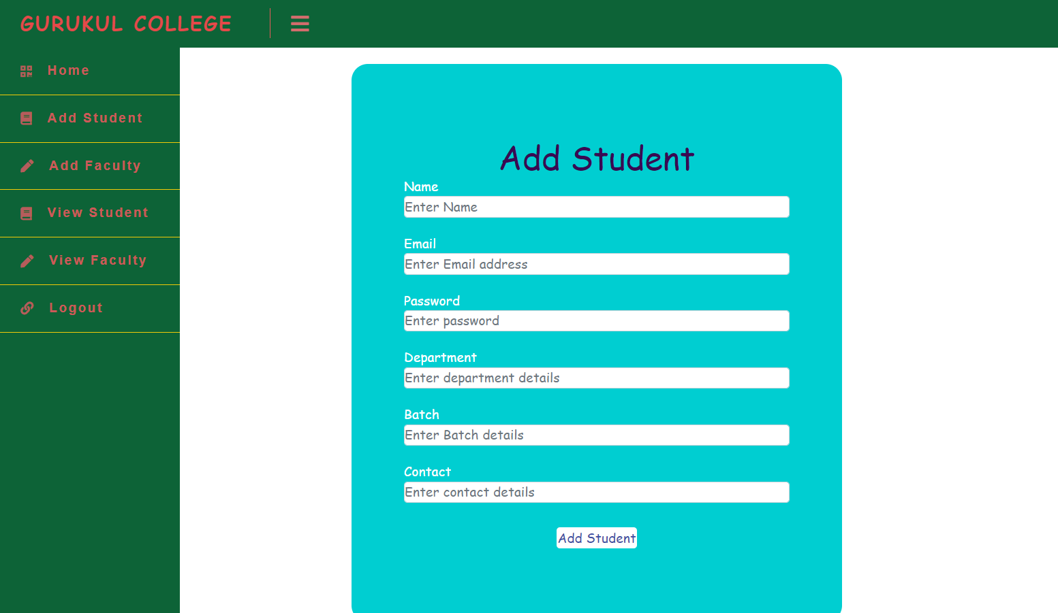
Add student

Slide 16

Add Faculty

Slide 17
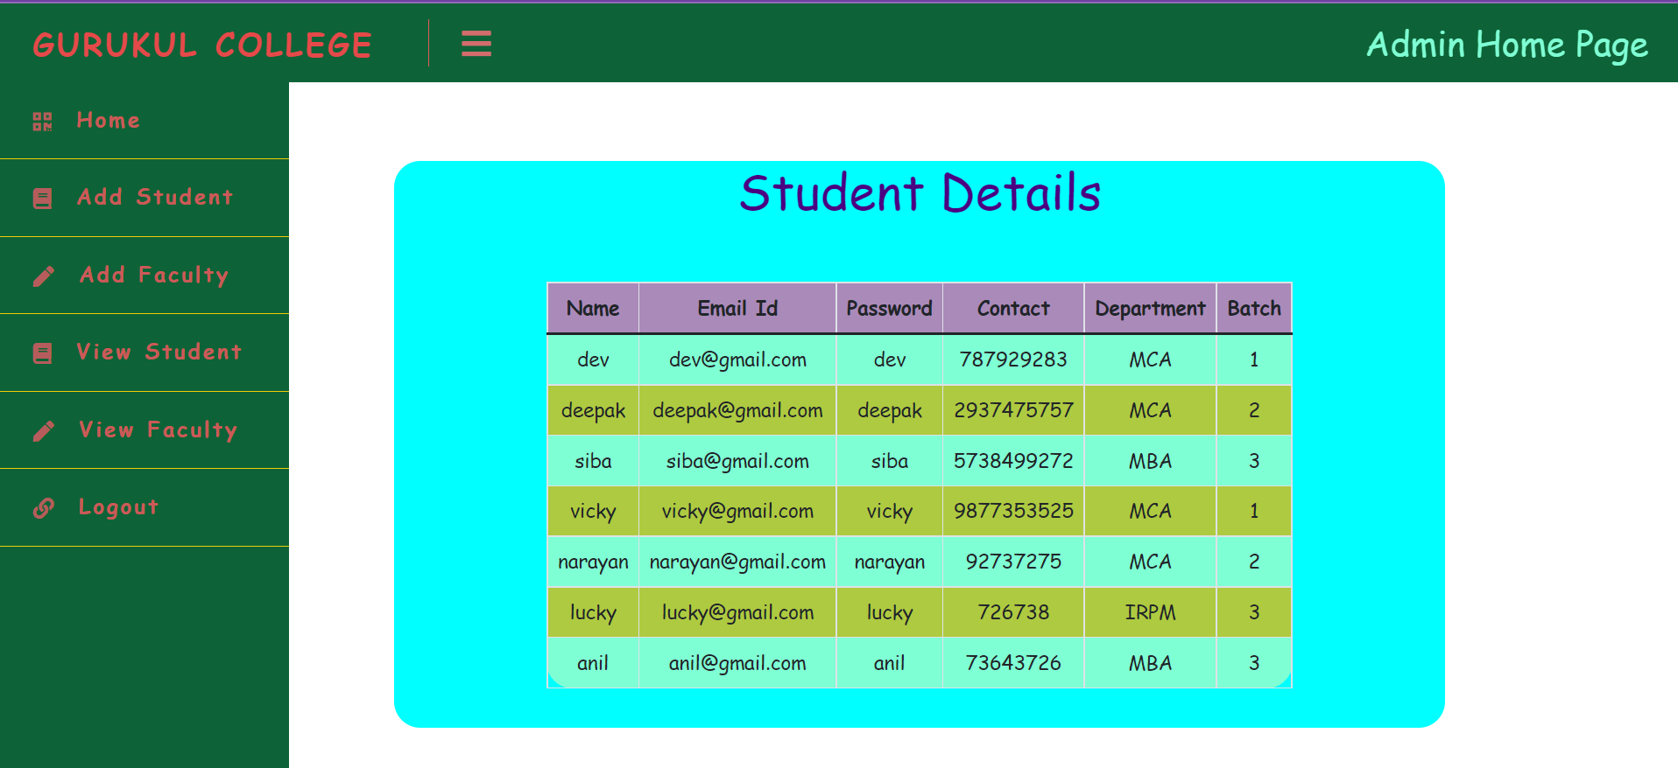
View Student

Slide 18
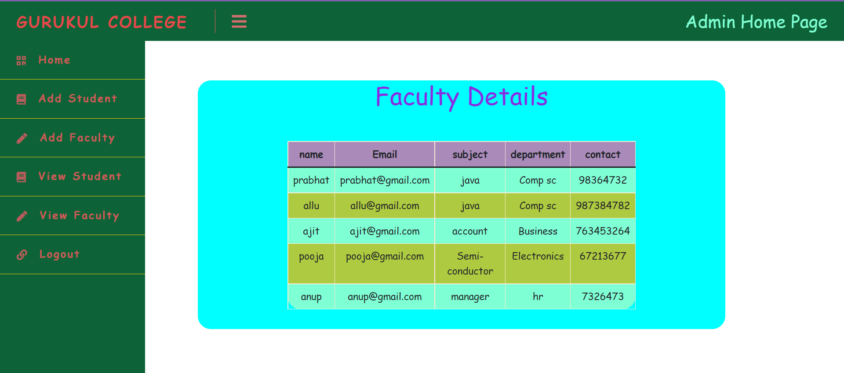
View Faculty

Slide 19

Student Home Page

Slide 20
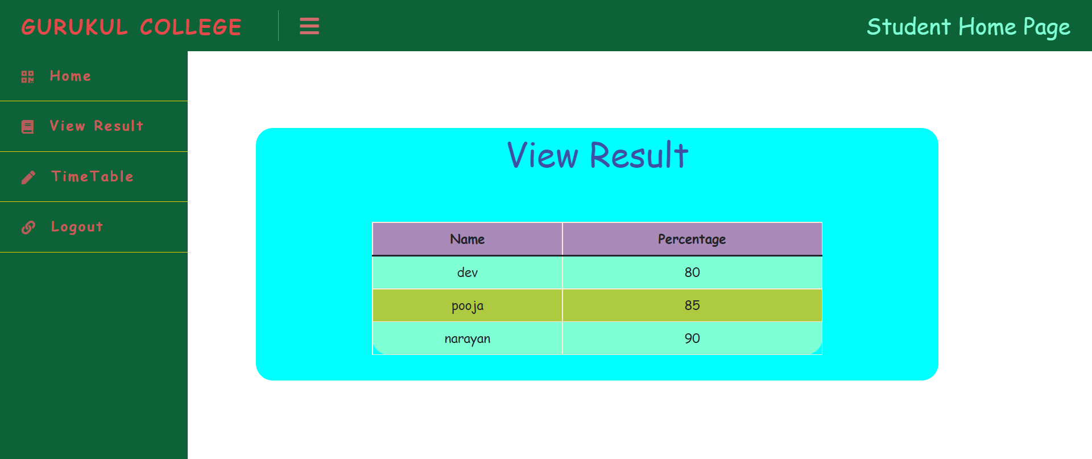
View result

Slide 21
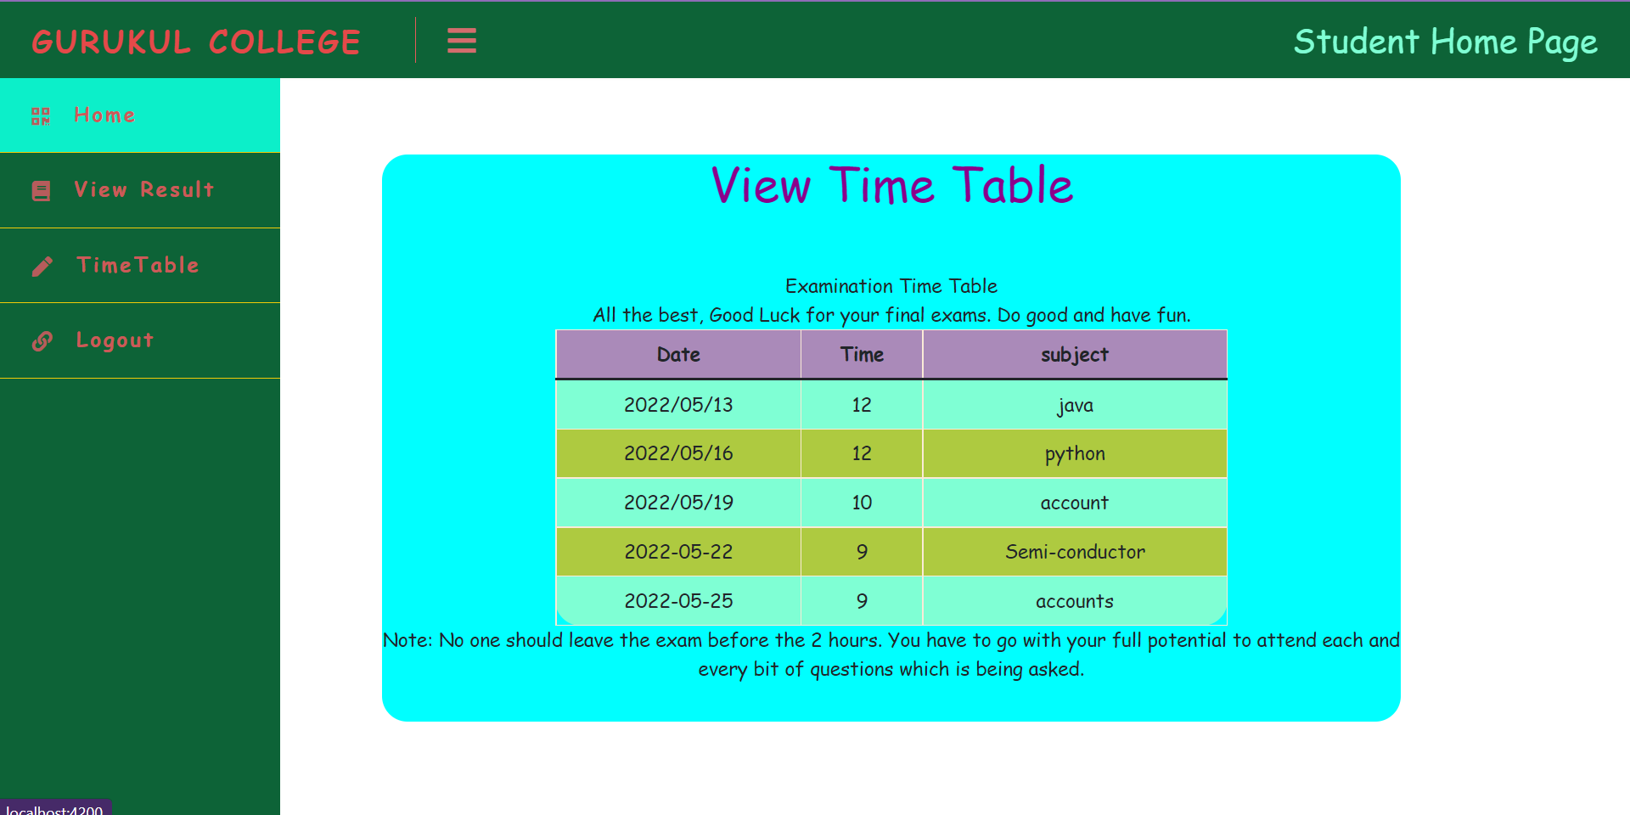
View time-table

Slide 22

Faculty Home page

Slide 23
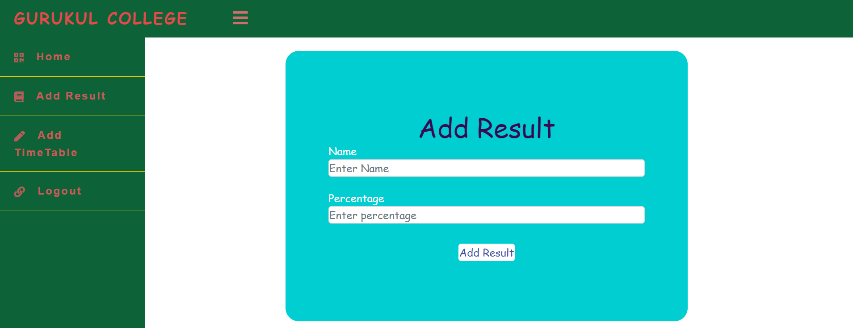
Add result

Slide 24
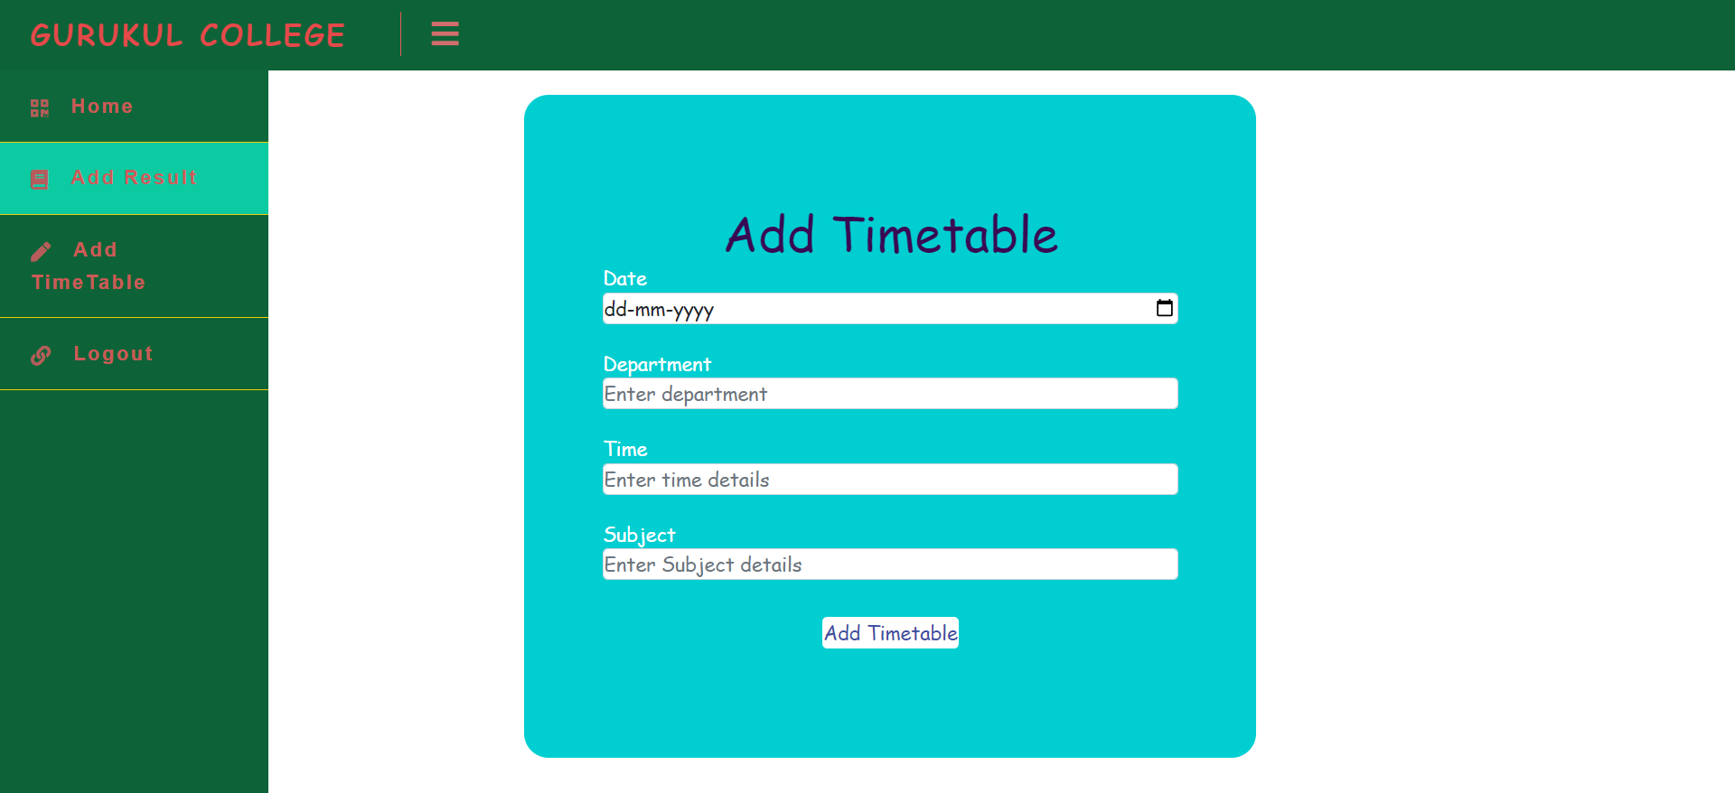
Add Time-table

Slide 25
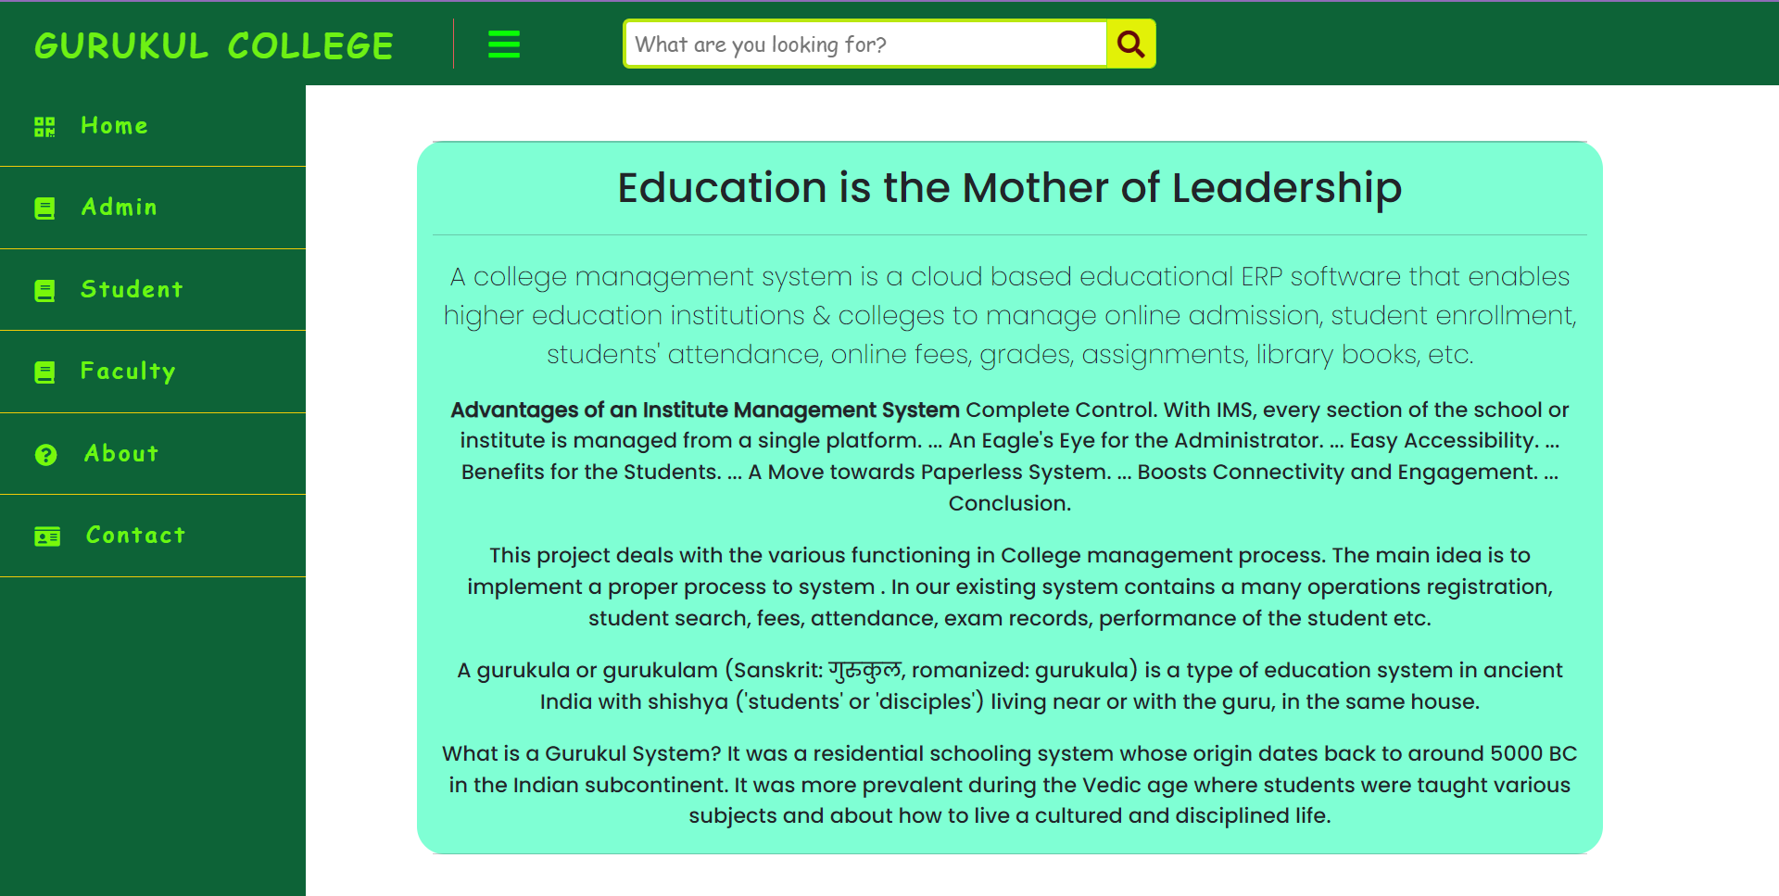
About Page

Slide 26
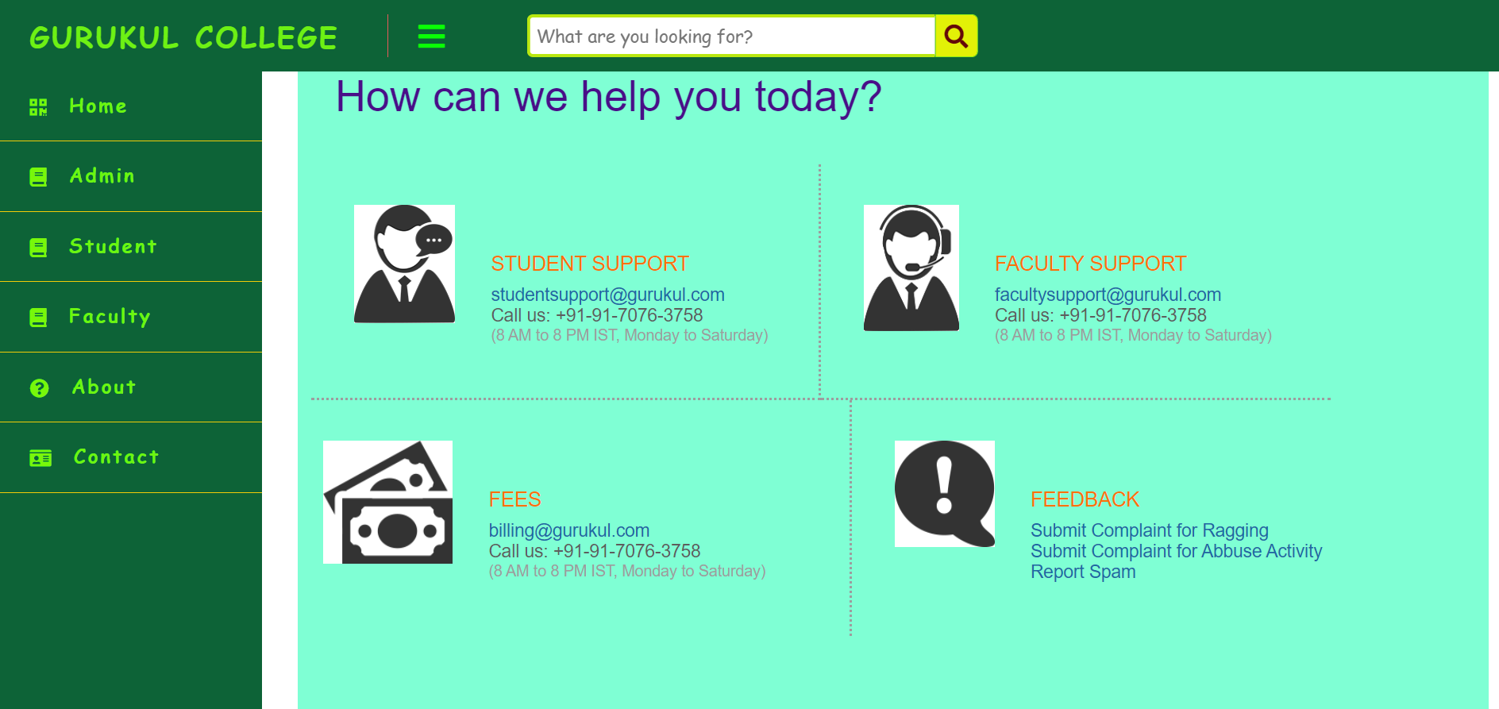
Contact Page

Slide 27
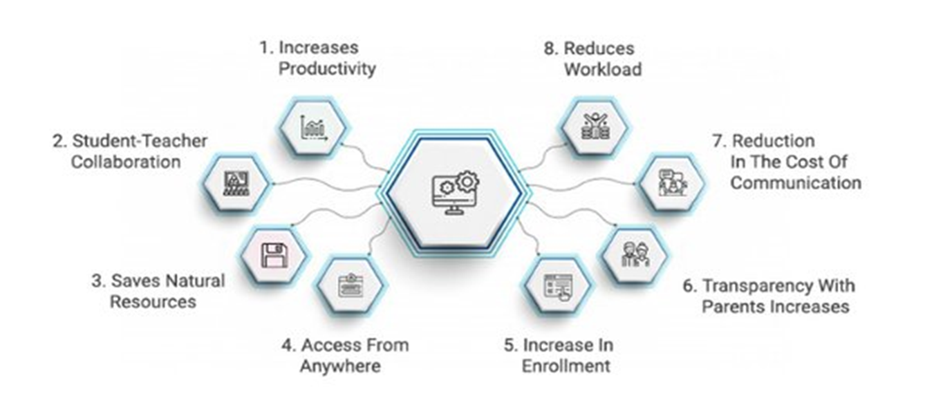
Advantages

Slide 28
Disadvantages
The installation of the ERP System is costly
Complex Data Conversion

Slide 29
Conclusion
The “ERP” system has been developed by us and also done enhancement in application through applying our knowledge gained in class room, referring to certain books, browsing some sites and through the help of external and internal faculties and using our knowledge related to subject it. We are very thankful to all our team members that extended all their support and helped us complete this project successfully.

Slide 30


